Slide 1
Bioinformatics Introduction
Sebastian Schmeier
s.schmeier@gmail.com
http://sschmeier.github.io/bioinf-workshop/
03.08.2015

Slide 2
Overview
Bioinformatics
Big data
Command line interface
Linux
Virtual machines
Sebastian Schmeier

Slide 3
Bioinformatics
From Wikipedia
“Bioinformatics is an interdisciplinary field that develops methods and software tools for understanding biological data. As an interdisciplinary field of science, bioinformatics combines computer science, statistics, mathematics, and engineering to study and process biological data”
Sebastian Schmeier

Slide 4
Bioinformatics
Biology
Mathematics
Bioinformatics
Medicine
Computer science
A multifaceted discipline
Sebastian Schmeier

Slide 5
Bioinformatics
Biologists + Clinicians
collect molecular data:
DNA & Protein sequences,
gene expression, mutations, etc
Bioinformaticians
Study biological questions by analyzing molecular data with the help of computers
Computer scientists
(+Mathematicians, Statisticians, etc.)
Develop tools, software, algorithms to store and analyze the data.
Sebastian Schmeier

Slide 6
Bioinformatics bag of tricks
Programming
Statistics
Databases
Algorithms
Bioinformatics
Web technologies
Creativity
Biological knowledge
Medical
knowledge
Sebastian Schmeier

Slide 7
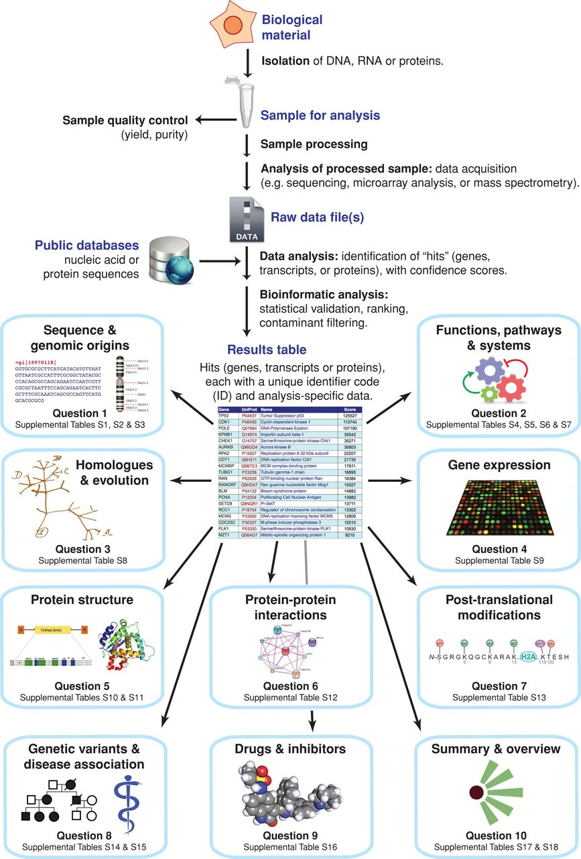
Bioinformatics and genome research?
Mol Biol Cell. 2014 Apr;25(8):1187-201
Bioinformatics
Sebastian Schmeier

Slide 8
Big data?
Data production in biology and medicine has outpaced our ability to analyse the incoming data → e.g. sequencing
Problems:
Data storage
Data transfer
Data security and privacy
…and we did not talk about the actual analysis yet.
Sebastian Schmeier

Slide 9
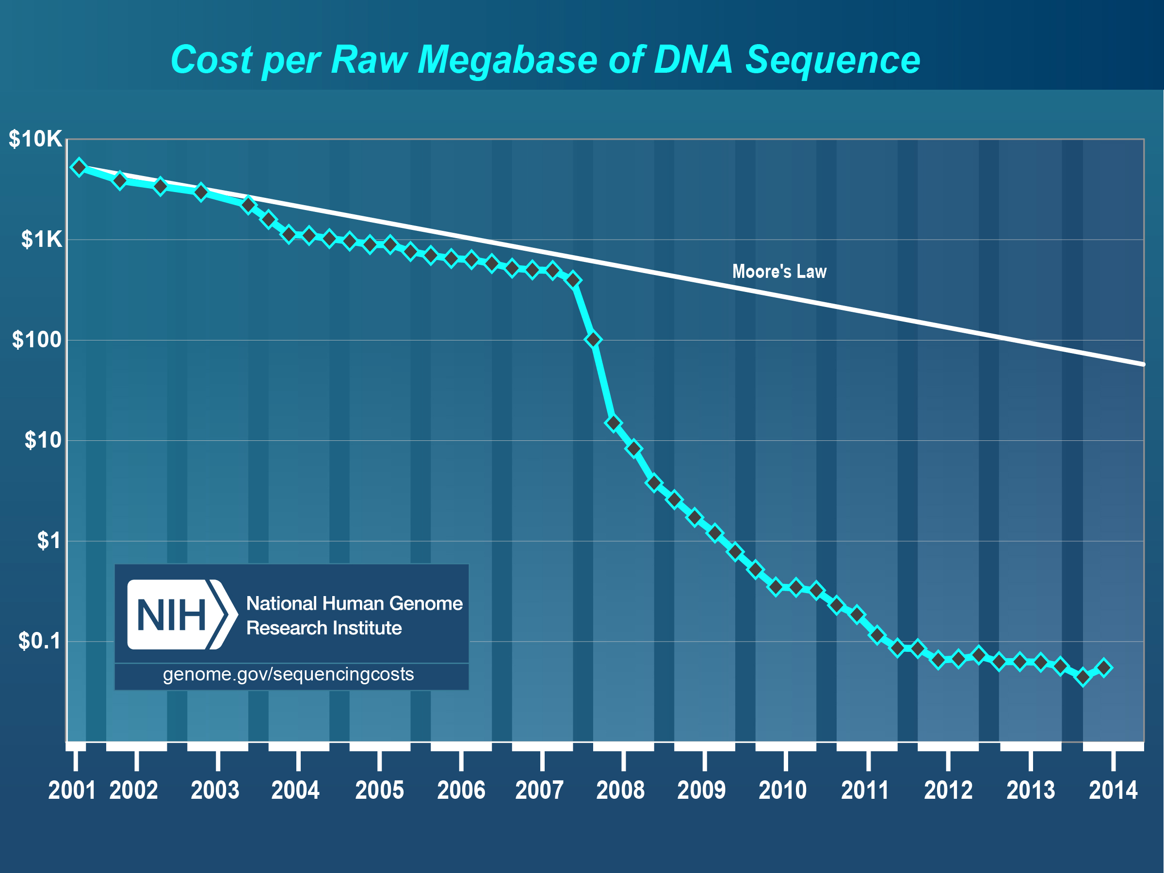
Big data?
Some examples:
2000: 1 genome → Human genome project
2008~2012: 1,000 genomes → 1,000 genome project
2008~?: 25,000 genomes → Int.l cancer genome project
2012~2017: 100,000 genomes → UK 100,000 genome project
10 Petabyte of data (10,000,000 GB, at 100GB per human genome)
mega base pair = 1,000,000 bp
Sebastian Schmeier

Slide 10
Analyzing “big” data
Currently Microsoft Excel has a row limit of about ~1 million rows
→ Excel is not suitable to work with large files
Version | Max. rows | Max. columns
Excel 2013 | 1,048,576 | 16,384
Excel 2010 | 1,048,576 | 16,384
Excel 2007 | 1,048,576 | 16,384
Excel 2003 | 65,536 | 256
Excel 2002 (XP) | 65,536 | 256
Excel 2000 | 65,536 | 256
Excel 97 | 65,536 | 256
Excel 95 | 16,384 | 256
Excel 5 | 16,384 | 256
Sebastian Schmeier

Slide 11
Alternative: plain text-files
What is a plain text-file
A file that is human readable
Readable as textual material without much processing →can be opened in any ordinary text editor
NO style information is included
NOT "binary files" in which some portions must be interpreted as binary objects (encoded integers, real numbers, images, etc.).
Its size is only limited by the operating systems file-system.
Sebastian Schmeier

Slide 12
Common file-systems and file-size limits
File-system | Max. file-size | Supported OS
FAT32 | 4 GB (Gigabyte) | Windows, Linux, Mac OSX
NTFS | ~16 EB (Exabyte) | Windows, Mac OSX
exFAT | ~16 EB (Exabyte) | Windows, Linux, Mac OSX
ext4 | ~ 16 TB (Terabyte) | Linux
HFS+ | 8 EB (Exabyte) | Mac OSX
Value | Name
1000 | kB | kilobyte
1000² | MB | megabyte
1000³ | GB | gigabyte
1000⁴ | TB | terabyte
1000⁵ | PB | petabyte
1000⁶ | EB | exabyt
Sebastian Schmeier

Slide 13
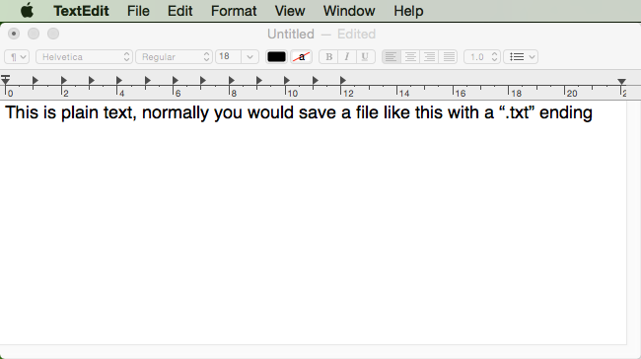
Working with plain text files
Generally speaking you can open plain text in any text editor, e.g. TextEdit (Mac)
However, you are limited in the amount of memory your computer has
Thus, large files cannot be opened in a text editor
Sebastian Schmeier

Slide 14
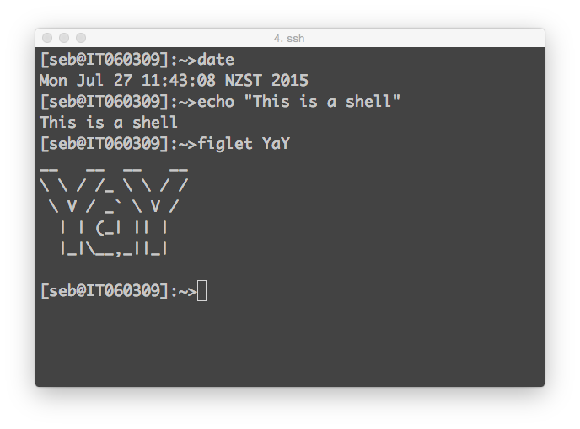
Command-line interface (CLI)
Many data scientist tend to work with a command-line interface on a terminal window
Here, one can interact with the operating system by issuing commands in form of successive lines of text (command lines)
Who has heard of the command-line?
Anyone tried to work with the command-line?
Sebastian Schmeier

Slide 15
Advantages of the CLI
Control
→ Possibility to access the operating system file-system and programs
Speed
Processing data only with the keyboard
No interaction with menus, etc. necessary
Saves resources
Terminal does not require much computer resources
able to run on many kinds of hardware
Able to script
Able to write most work processes in forms of small scripts
This makes it even speedier and also
Remote access
→ Processing data from different computers over the network is simple
Reproducibility
Placing the commands in a script or text-file lets one see/reproduce all steps taken to get to the result
Less strain
→ Less switching between keyboard and mouse
Sebastian Schmeier

Slide 16
Disadvantages of the CLI
No fancy user interface
→ Everything happens in the terminal window
Not able to navigate with mouse
One needs to input command-lines
one by one
Needs to remember important commands
→ No menus available to hunt through to find the right commands
Sebastian Schmeier

Slide 17
Where can I use the CLI
Windows has a very rudimentary CLI (shell)
not very user friendly, many essential programs are missing
Mac OSX has a Terminal program
→ needs some tinkering to make it fully usable
Linux in-built terminal
→Most comprehensive set of CLI programs available
Who is working on Windows?
Who is working on Mac OSX?
Who has heard of Linux?
Who has worked with Linux?
Sebastian Schmeier

Slide 18
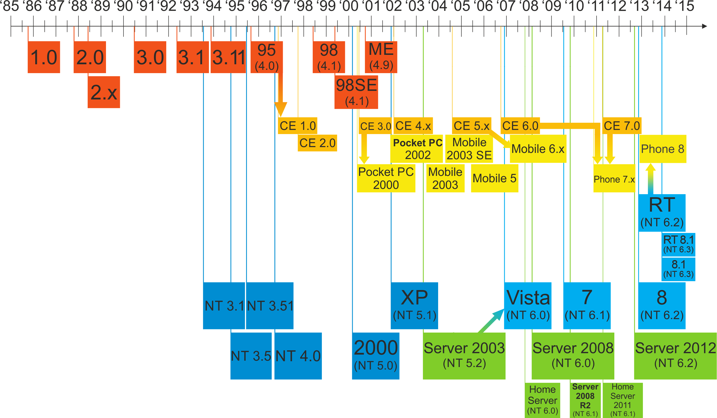
Evolution of computer operating systems
Microsoft
Windows
https://upload.wikimedia.org/wikipedia/commons/6/6d/Windows_Updated_Family_Tree.png
Sebastian Schmeier

Slide 19
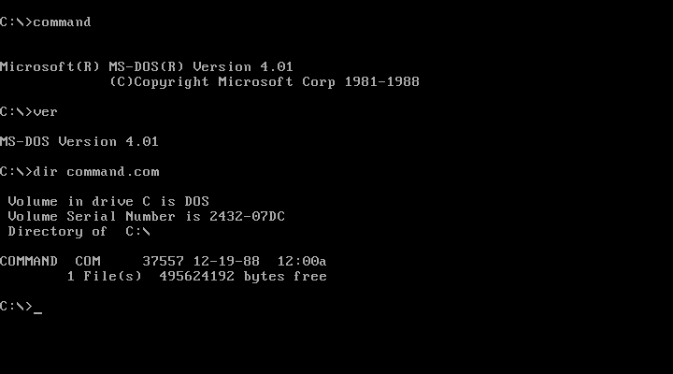
https://en.wikipedia.org/wiki/Windows_1.0
Sebastian Schmeier
Image Source: Computer History Museum

Slide 20
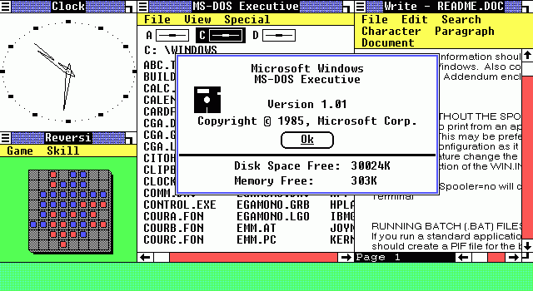
https://en.wikipedia.org/wiki/Windows_1.0
Sebastian Schmeier

Slide 21
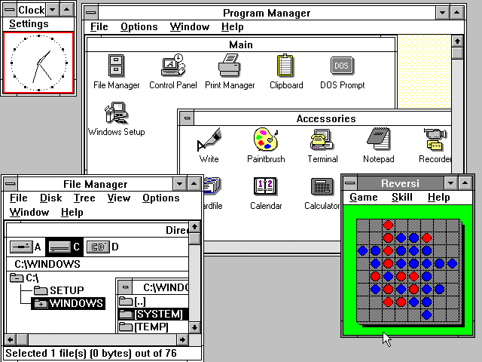
1990
https://en.wikipedia.org/wiki/Windows_3.0
Sebastian Schmeier

Slide 22
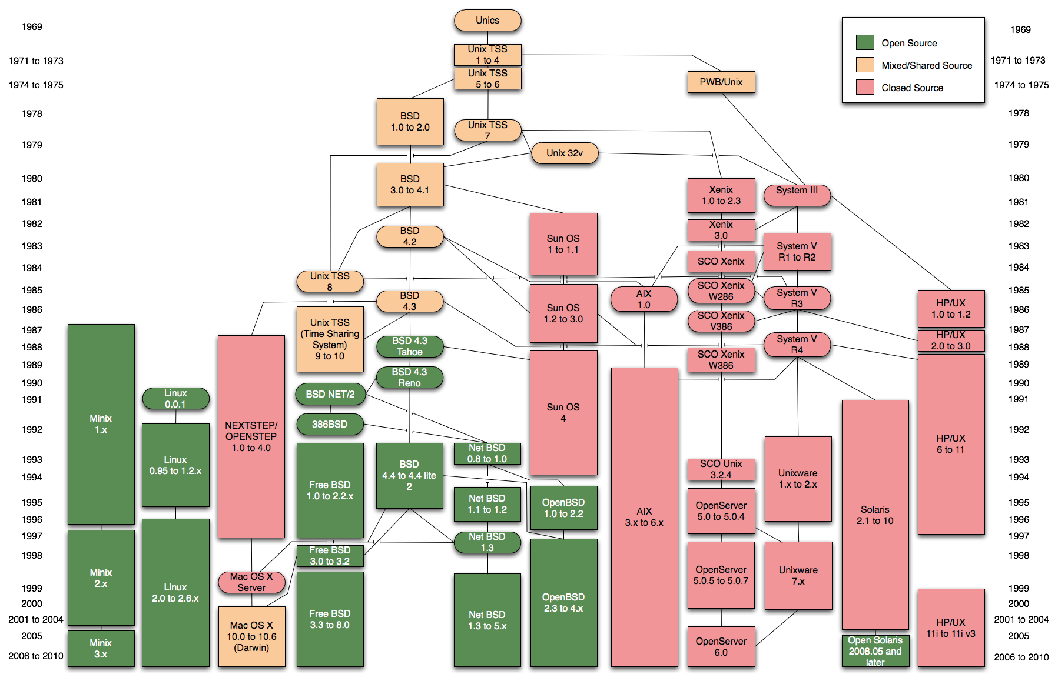
Evolution of computer operating systems
Finnish student Linus Torvalds created a new free operating system kernel in 1991
https://commons.wikimedia.org/wiki/File:Unix_history-simple.png
Sebastian Schmeier

Slide 23
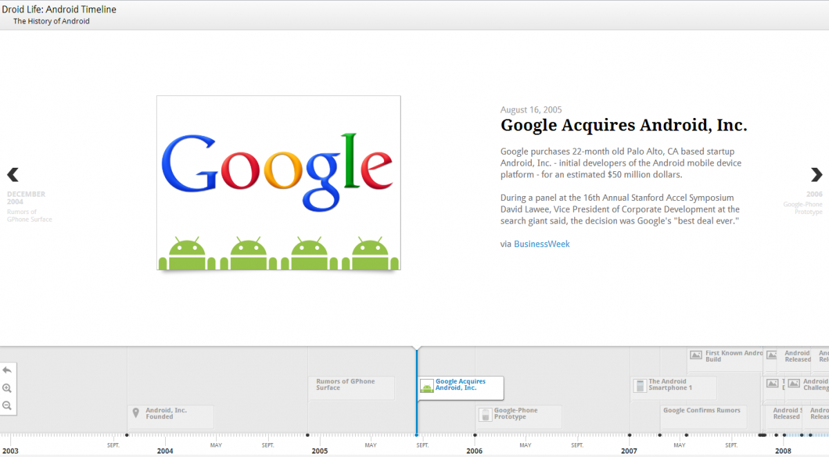

Yes! Android as well
2005: Google acquired Android Inc. for at least $50 million
2013: Google's Linux-based Android claims 75% of the smartphone market share, in terms of the #phones shipped.
Sebastian Schmeier

Slide 24

Advantages of Linux-based computers
Free
Open-source
Customizable
Alternatives/Choice
Security
Huge community
Being able to contribute
Low on resource / also good for old hardware
…
Sebastian Schmeier

Slide 25

Disadvantages of Linux-based computers
Won’t run any Windows programs natively e.g. Word, Excel, Powerpoint, Photoshop etc.
For some peripheral hardware there are no Linux drivers available
Requires some getting used to for first time users
There is no “standard Linux” edition
Support is sometimes harder to come by and some technical background is sometimes required to understand solutions
Gaming is not YET as easily done on a Linux computer
Sebastian Schmeier

Slide 26







Most popular Linux distributions
Ubuntu
Mint
Debian
Fedora
Mageia
openSUSE
ArchLinux
Many more distributions available. Some distributions build on other distributions and enhance them with certain feature sets.
http://distrowatch.com/dwres.php?resource=major
Sebastian Schmeier

Slide 27

BioLinux 8
Based on Ubuntu Linux
Powerful, free bioinformatics workstation platform
can be installed on anything from a laptop to a large server, or run as a virtual machine.
Adds more than 250 bioinformatics packages to an Ubuntu Linux 14.04 LTS base, providing around 50 graphical applications and several hundred command line tools.
Incorporates the Galaxy environment for browser-based data analysis and workflow construction
Field, D., Tiwari, B., Booth, T., Houten, S., Swan, D., Bertrand, N. and Thurston, M. 2006. Open Software for biologists: from famine to feast. Nature Biotechnology 24, 801–803.
http://environmentalomics.org/bio-linux/
Sebastian Schmeier

Slide 28
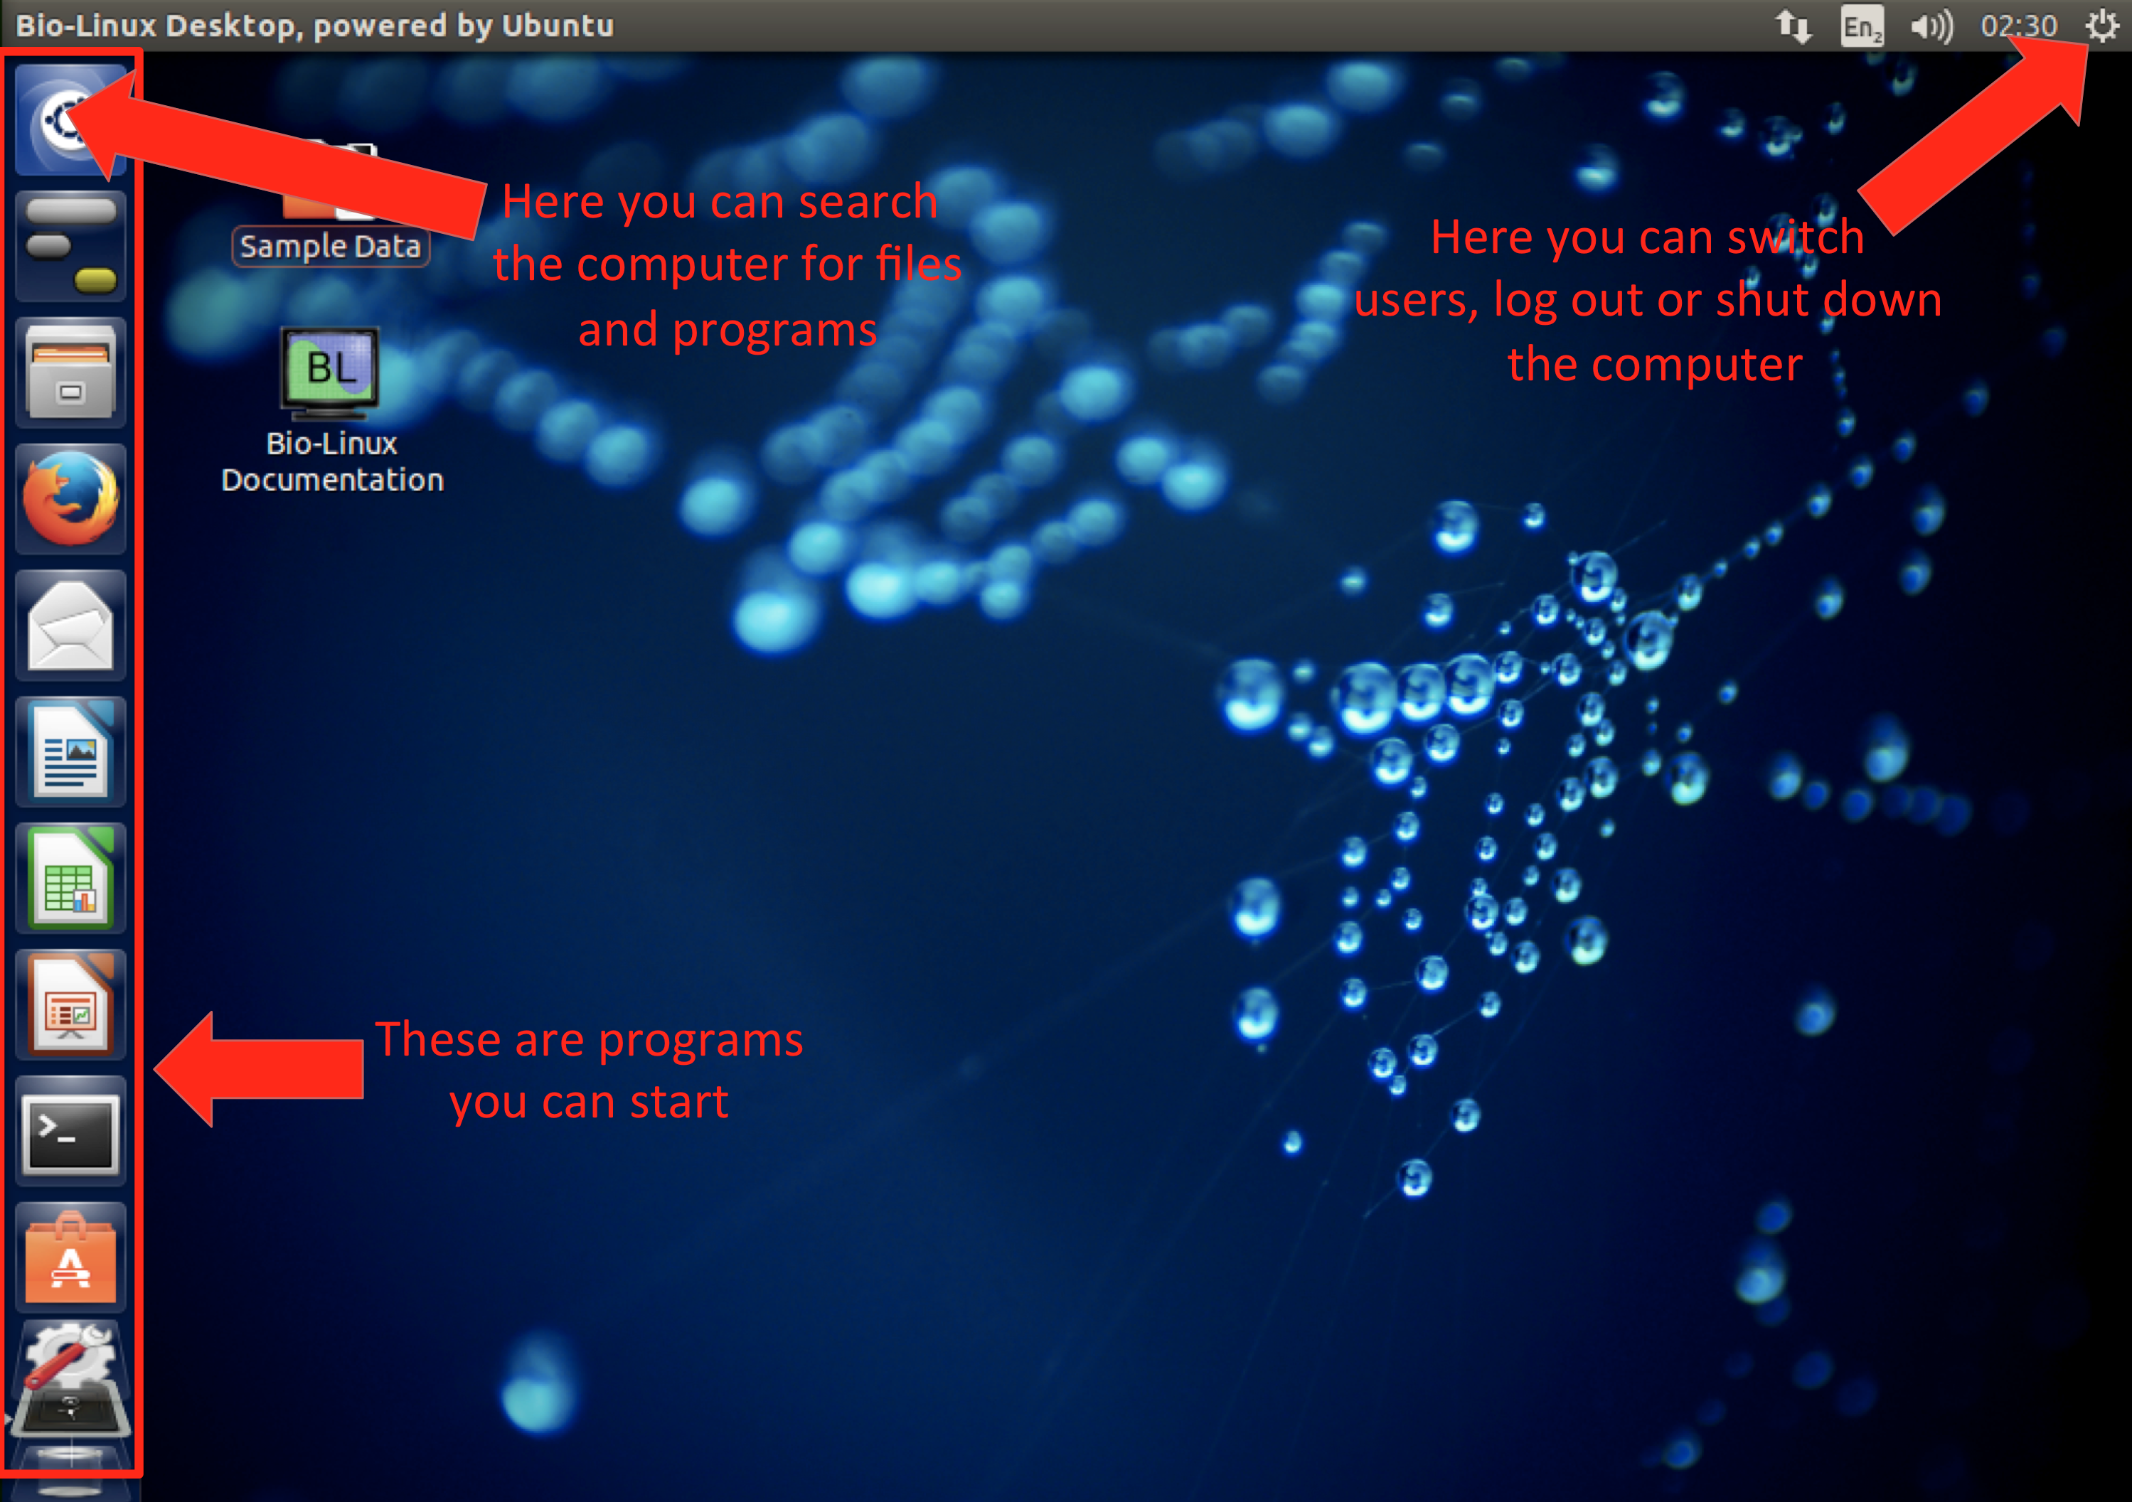
The BioLinux user interface (Unity)
Sebastian Schmeier

Slide 29
How to run Linux
There are several options available:
Install it on a computer:
Either instead of your original OS or along side your OS (called dual boot)
Run Linux of a LiveCD:
This requires you to boot from a DVD that contains the Linux Live version. However, once you shutdown the Live version of Linux all your saved data is lost. This is a choice if you want to try out a Linux distro without an actual install.
Run Linux inside a Virtual machine:
This a great option if you have a powerful pc/laptop. You can install a virtualisation software for free, e.g. VirtualBox and install Linux from a disk image into a new virtual machine. The advantage is that if you break your Linux machine (which is generally hard to do), you easily can reinstall it, as the virtual machine is basically only a file on your computer (https://www.virtualbox.org/)
We will be running BioLinux as a virtual machine
Sebastian Schmeier

Slide 30
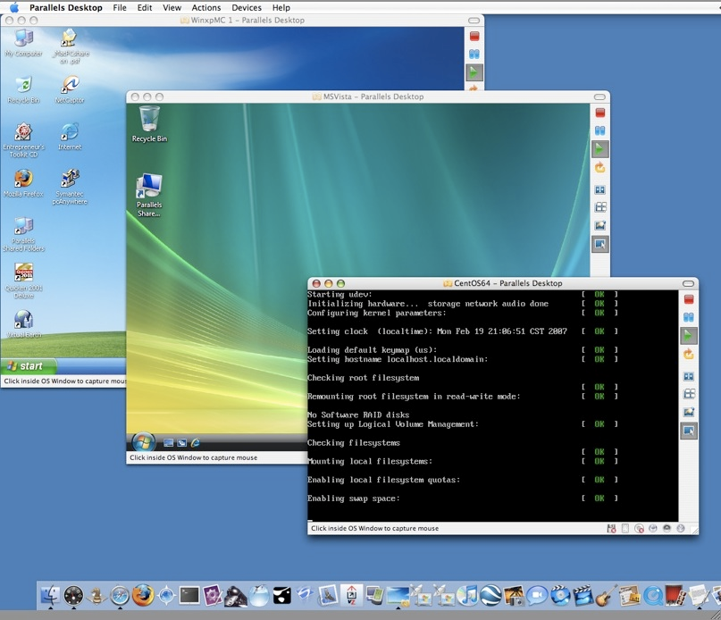
Virtual machines (VMs)
Basically the idea is to install a OS into a container, which is a single file.
The virtualization software will start/run the OS from that file, e.g. uses the file as a hard-drive.
An window within your host OS will open that shows the “virtual” OS running in the container.
Sebastian Schmeier

Slide 31
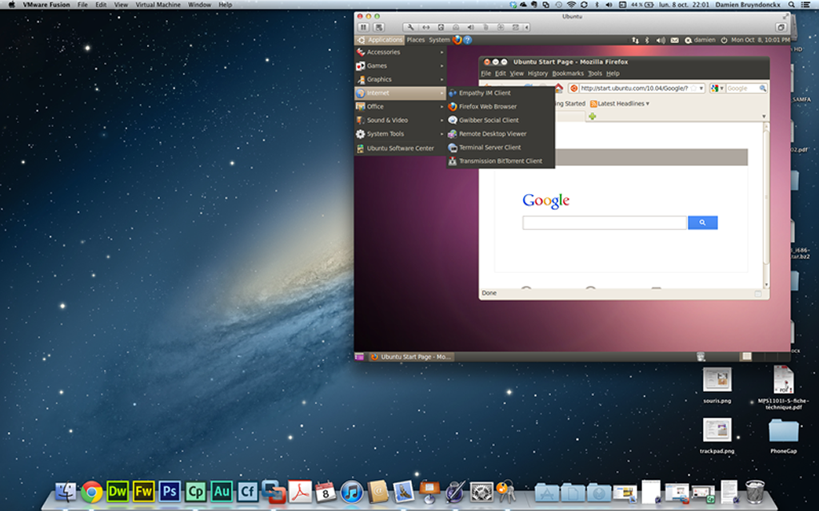
Virtual machines (2)
Once you go over the window with your mouse you will be moving around inside the “virtual” OS.
You can exchange files with the host OS through specifically created folders (this is needs configuration)
The “virtual” OS will use as many host OS computer resources as you have allocated during the installation
Sebastian Schmeier

Slide 32

Computing philosophy
Unlike your Science...
Be lazy.
Copy others.
Don't invent anything you don't have to.
Re-USE, re-CYCLE, DON'T re-invent.
Don't be afraid to ask others.
Resort to new code only when absolutely necessary.
Add comments to your code - ALWAYS
Sebastian Schmeier

Slide 33
Computing philosophy (2)
You're not a CS, not a programmers
Don't try to be them
But! Try to think like them, at least a bit
Google is your friend
Sebastian Schmeier

Slide 34
Questions?
Sebastian Schmeier
s.schmeier@gmail.com
http://sschmeier.github.io/bioinf-workshop/

